Slide 1

Guidelines for Adult Stroke Rehabilitation and Recovery
Prof. Dr. Jos Tournoy
BIUGM course: 24 november 2023
BMS internal review number 432BE17PR01104/170116

Slide 2
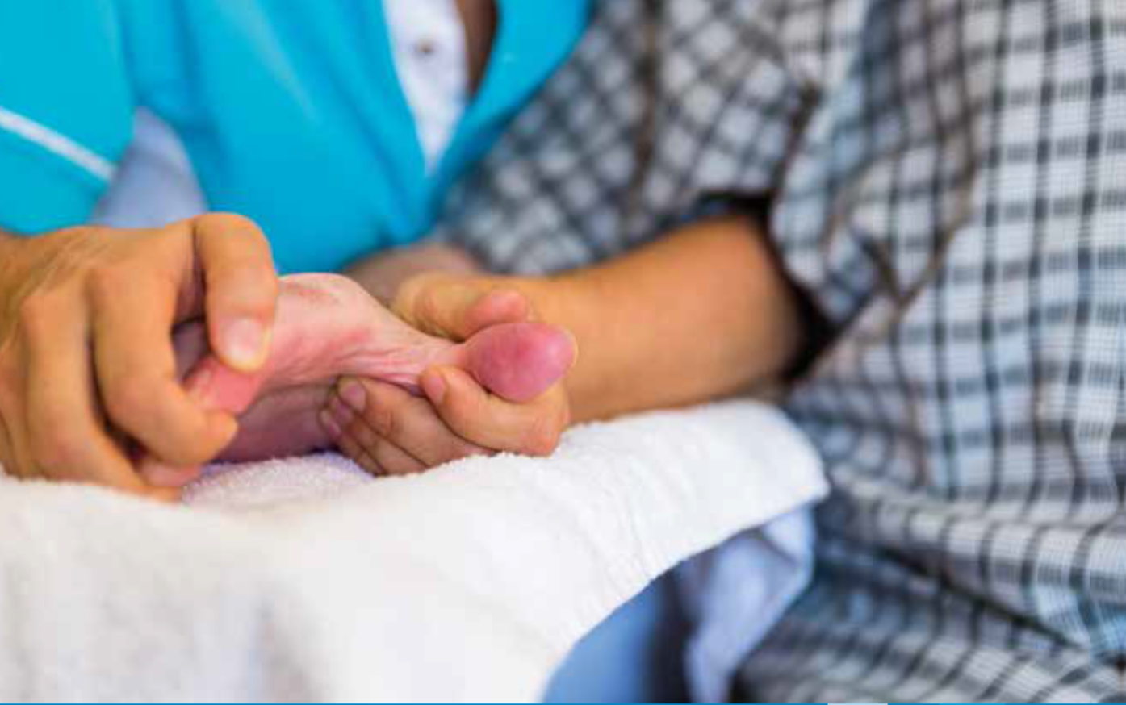
Rehabilitation medicine
  Aim: to maximise function and to minimise limitation of activity and restriction of participation resulting from a disease, trauma or a congenital disorder
https://www.ahajournals.org/doi/full/10.1161/STR.0000000000000098
https://www.strokeguideline.org/app/uploads/2023/04/National-Clinical-Guideline-for-Stroke-2023.pdf

Slide 3

Rehabilitation medicine
  Stabilisation of the primary problem
  Prevention of secondary complications
  Maximising functions
  Adaptation of a person to his/her environment
  Adaptation of the environment to the person
  Stimulation of the family to come to a joint effort

Slide 4
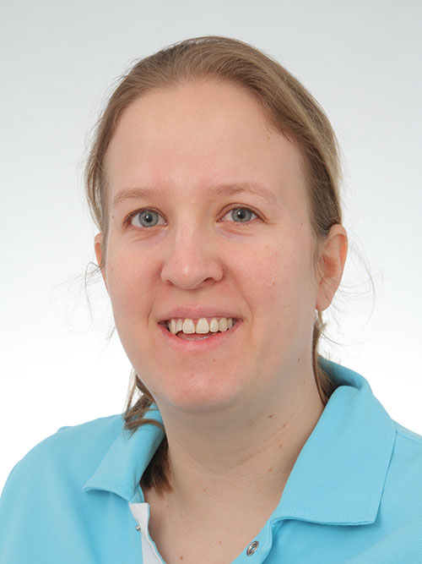
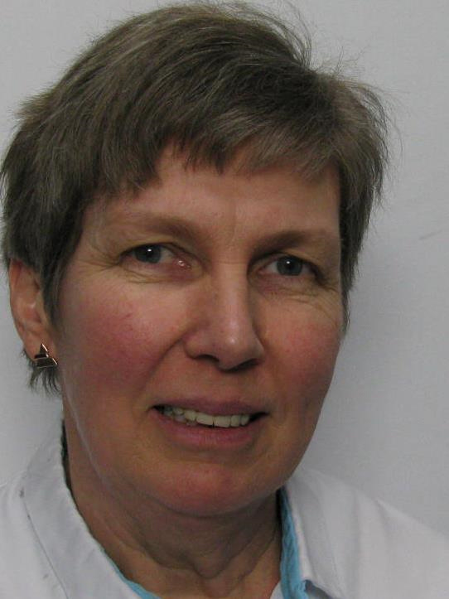
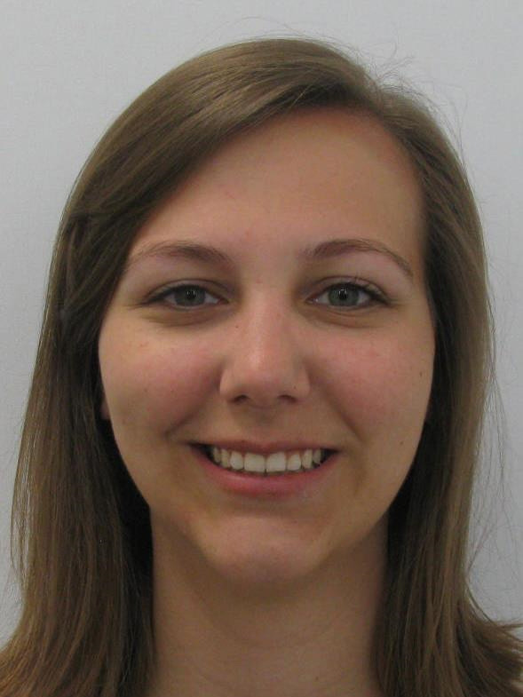
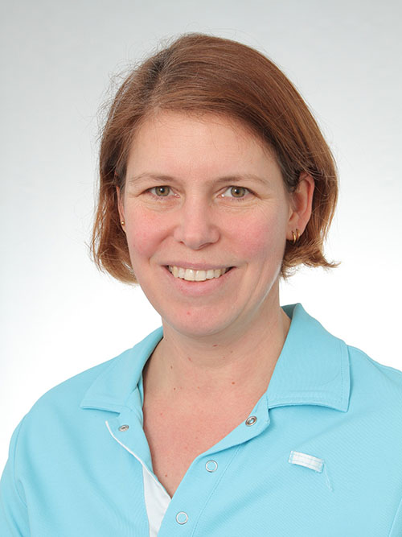
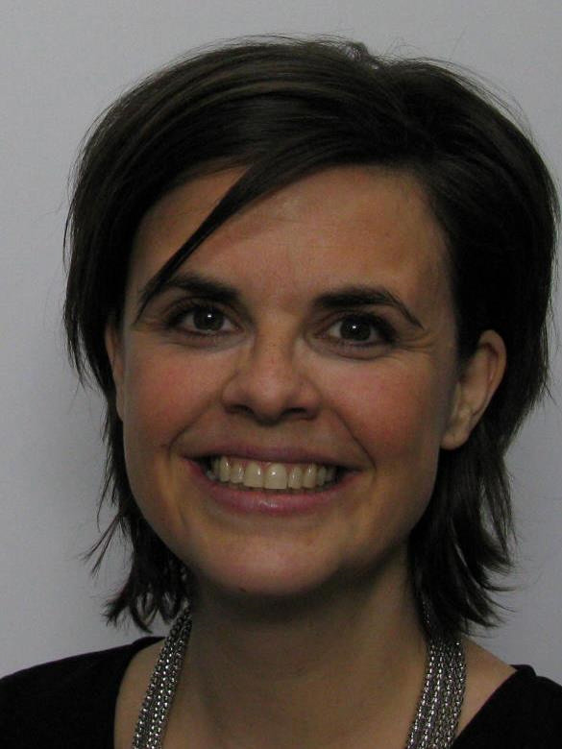
The rehabilitation team

Slide 5
Geriatrische revalidatie kent heikele financiering (G bed)-conventie nodig/aangewezen
http://www.riziv.fgov.be/nl/themas/kost-terugbetaling/ziekten/locomotorische-handicaps/Paginas/behandeling-revalidatiecentra.aspx#.V9j1U03r2Uk

Slide 6
Aanbevelingen therapie
People with motor recovery goals undergoing rehabilitation after a stroke should receive a
minimum of 3 hours of multidisciplinary therapy a day (delivered or supervised by a
therapist or rehabilitation assistant focused on exercise, motor retraining and/or
functional practice), at least 5 days out of 7, to enable the range of required interventions
to be delivered at an effective dose.
People undergoing rehabilitation after a stroke should be supported to remain active
for up to 6 hours a day (including therapist-delivered therapy), for example through
the use of open gyms, self-practice, carer-assisted practice, engaging in activities of
daily living, and activities promoting cardiovascular fitness. [2023] UK national stroke guidelines
UK national stroke guidelines

Slide 7
Organization of Post-Stroke Rehabilitation Care
  Stroke patients who are candidates for post-acute rehab should receive organized, coordinated, inter-professional care (Class I, LOE A)
  Stroke survivors who qualify for and have access to IRF care should receive treatment in an IRF in preference to a SNF (Class I, LOE B)
  Organized community-based and coordinated inter-professional rehab is recommended in the outpatient and/or home-based settings (Class I, LOE C)

Slide 8
A People with stroke should be actively involved in their rehabilitation through:
‒ having their feelings, wishes and expectations for recovery understood and acknowledged;
‒ participating in the process of goal setting unless they choose not to, or are unable to because of the severity of their cognitive or linguistic impairments;
B People with stroke should be helped to identify goals that:
‒ are meaningful and relevant to them;
‒ are challenging but achievable;
‒ aim to achieve both short-term (days/weeks) and long-term (weeks/months) objectives;
‒ are documented, with specific, time-bound and measurable outcomes;
‒ have achievement measured and evaluated in a consistent way;
‒ include family/carers where this is appropriate;
‒ are used to guide and inform therapy and treatment. [2016]
C People with stroke should be supported and involved in a self-management approach to their rehabilitation goals.
Doelbepaling

Slide 9
Prevention and management of comorbidities
Stroke recurrence risk factors
Secondary stroke prophylaxis
Medical comorbidities and effects on post acute care needs
DVT prophylaxis
Cognition
Dysphagia
Nutrition
Mobility/self care
Bowel/bladder function
Skin integrity
Caregiver availability
Patient/caregiver education
Depression/mental health screen
Spasticity
Durable medical equipment/orthotic needs
Recommendation regarding transition to appropriate level of post acute care and follow up with physiatry/rehabilitation physician for future stroke rehabilitation needs

Slide 10
Prevention and medical management of comorbidities
Prevention of Skin Breakdown and Contractures
  Regular assessment of skin -objective scales are valuable in the prevention of skin injury and should be followed by regular skin inspection with documentation. (Class I, LOE C recommendation)
  It is recommended to minimize or eliminate skin friction, minimize skin pressure, provide appropriate support surfaces, avoid excessive moisture, and maintain adequate nutrition & hydration to prevent skin breakdown. Regular turning (at least every 2 hours), good skin hygiene, use of specialized mattresses and wheelchair cushion and seating are recommended until mobility returns (Class I, LOE C recommendation)
  Patients, staff, and caregivers should be educated about the prevention of skin breakdown (Class I, LOE C)
  Up to 60% of patients develop joint contractures on the hemiparetic side within the 1st year. These contractures can cause pain and make dressing, hygiene, & other self-care difficult.

Slide 11
Prevention and medical management of comorbidities
Prevention of Deep Venous Thrombosis
  Recommendations for prevention of DVT and PE in ischemic stroke are described in great detail in the American College of Chest Physicians (ACCP) Antithrombotic Therapy and Prevention of Thrombosis. (9th ed.)
  Overall, the ACCP guidelines found an estimated reduction in overall mortality of 12 deaths per 1000 individuals receiving either UFH or LMWH compared with no anticoagulation. No form of prophylaxis is 100%,
  In the case of ICH: it may be reasonable to use prophylactic-dose SQ heparin (UFH or LMWH) started between days 2 and 4 over no prophylaxis. (Class IIb, LOE C)

Slide 12
Prevention and medical management of comorbidities
Treatment of Bowel and Bladder Incontinence
  Recommend assessment of bladder function in acutely hospitalized stroke patients. Specifically:
    A history of urological issues prior to stroke should be obtained. (Class I, LOE B)
    Assessment of urinary retention through bladder scanning or intermittent catheterizations post voiding while recording volumes is recommended for patients with urinary incontinence or retention. (Class I, LOE B)
  Removal of the foley catheter (if any) within 24 hours after admission for acute stroke is recommended, based on the CDC recommendations for all hospitalized patients. (Class I, LOE B)
  It is reasonable to use the following treatment interventions to improve bladder incontinence in stroke patients: (Class IIa, LOE B)
    Prompted voiding;
    Pelvic floor muscle training (after discharge home)
  It may be reasonable to assess prior bowel function in acutely hospitalized stroke patients and include the following: (Class IIb, LOE C)
    Stool consistency, frequency, and timing (pre-stroke).
    Bowel care practices prior to stroke.
science is why

Slide 13
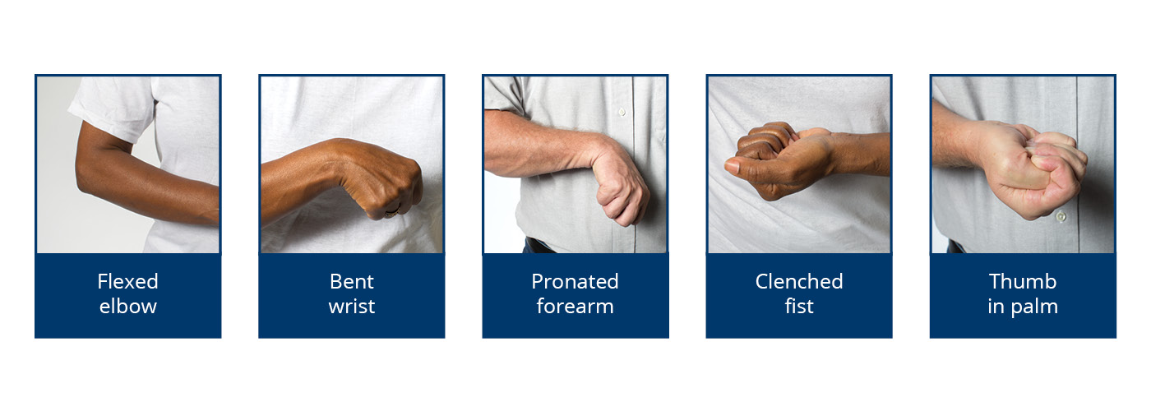
Specific recommandations: Spasticity
  Spasticity is classically defined as a velocity-dependent resistance to stretch of a muscle and is one component of the upper motor neuron syndrome.
  Spasticity is correlated with activity limitations associated with hygiene, dressing, and pain.
  These activity limitations increase caregiver burden and reduce quality of life as measured by the EuroQol-5.
science is why

Slide 14
Specific recommendations: Spasticity
  Targeted injection of botulinum toxin into localized upper limb muscles is recommended to reduce spasticity, improve passive or active range of motion, and improve dressing, hygiene and limb positioning. (Class I, LOE A)
  Targeted injection of botulinum toxin into lower limb muscles is recommended to reduce spasticity that interferes with gait function. (Class I, LOE A)
  Oral antispasticity agents can be useful for generalized spastic dystonia, but may result in dose-limiting sedation or other side effects. (Class IIa, LOE A)
science is why

Slide 15
Prevention and medical management of comorbidities
Prevention of Falls
  The evidence specific for fall prevention and interventions in persons with stroke is limited. Most assessment tools and evidence-based recommendations are derived from studies on general population of older adults.
  It is recommended that persons with stroke discharged to community participate in exercise programs with balance training to reduce falls. (Class I, LOE B)
  It is recommended that persons with stroke be provided a formal fall prevention program during hospitalization. (Class I, LOE A)
  It is reasonable that persons with stroke be evaluated for fall risk annually using an established instrument appropriate to the setting. (Class IIa, LOE B)
  It is reasonable that persons with stroke, and their caregivers, receive information targeted to home and environmental modifications designed to reduce falls. (Class IIa, LOE B)
  Tai Chi training may be reasonable for fall prevention. (Class IIb, B)
science is why

Slide 16
Prevention and medical management of comorbidities
Secondary Stroke Prevention
  Stroke shares many risk factors with other forms of cardiovascular disease, such as hypertension, smoking, hyperlipidemia, and inactivity.
  With hospitalization for acute stroke brief, it is particularly important to address secondary prevention of stroke and other cardiovascular diseases during the post-acute rehabilitation phase of care.
  See the 2014 AHA/ASA secondary stroke prevention guidelines:
– Kernan WN, Ovbiagele B, Black HR, Bravata DM, Chimowitz MI, Ezekowitz MD, Fang MC, Fisher M, Furie KL, Heck DV, Johnston SC, Kasner SE, Kittner SJ, Mitchell PH, Rich MW, Richardson D, Schwamm LH, Wilson JA. Guidelines for the prevention of stroke in patients with stroke and transient ischemic attack: a guideline for healthcare professionals from the American Heart Association/American Stroke Association. Stroke. 2014;45:2160-2236.
science is why

Slide 17
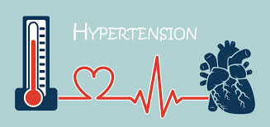
Hypertension
*Initiation of BP therapy is indicated for previously untreated patients with ischemic stroke or TIA who, after the first several days, have an established BP ≥140 mm Hg systolic or ≥90 mm Hg diastolic (Class I; Level of Evidence B).Initiation of therapy for patients with BP <140 mm Hg systolic and <90 mm Hg diastolic is of uncertain benefit (Class IIb; Level of Evidence C).
*See also RIVIZ report Hypertension
http://www.riziv.fgov.be/SiteCollectionDocuments/consensus_lange_tekst_20151105.pdf
People with stroke or TIA should have their blood pressure checked, and treatment should be initiated or increased as tolerated to consistently achieve a clinic systolic blood pressure below 130 mmHg (UK stroke guideline)

Slide 18
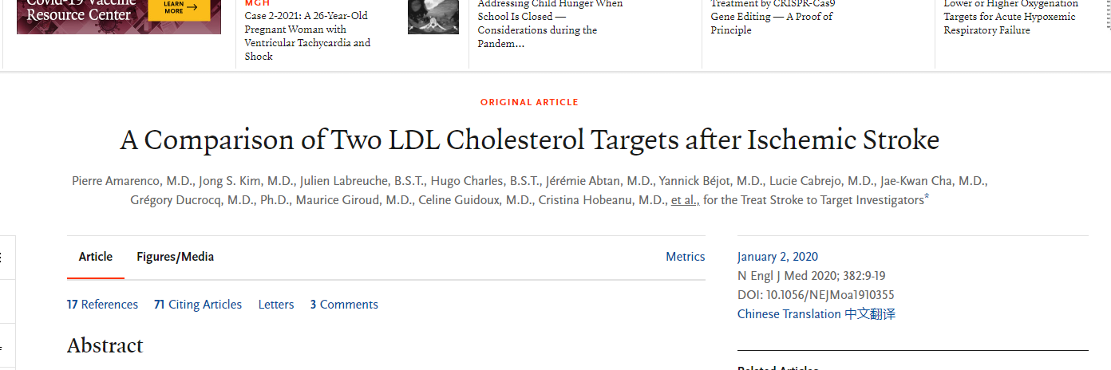
Dyslipidemia
  Initiation of a high-intensity statin is recommended up to age 75, and initiation of a moderate-intensity statin is recommended if age >75 years or if there are safety concerns with a high-intensity statin such as a history of hemorrhagic stroke, poorly controlled hypertension, or other serious comorbidities.
Dandapat, S. & Robinson, J.G. Curr Neurol Neurosci Rep (2016) 16: 24. https://doi.org/10.1007/s11910-016-0621-1
After an ischemic stroke or TIA with evidence of atherosclerosis, patients who had a target LDL cholesterol level of less than 70 mg per deciliter had a lower risk of subsequent cardiovascular events than those who had a target range of 90 mg to 110 mg per deciliter.

Slide 19
Mobility Recommendations
  Intensive, repetitive, mobility-task training is recommended for all individuals with gait limitations after stroke. (Class I, LOE A)
  Group therapy with circuit training is a reasonable approach to improve walking. (Class IIa, LOE A)
  Incorporating cardiovascular exercise and strengthening interventions is reasonable to consider for recovery of gait capacity and gait-related mobility tasks. (Class IIa, LOE A)
  Virtual reality may be beneficial for the improvement of gait. (Class IIb, LOE B)
  An ankle-foot orthoses (AFO) following stroke is recommended in individuals with remediable gait impairments (e.g., foot drop) to compensate for foot drop, and to improve mobility and paretic ankle and knee kinematics, kinetics and energy cost of walking. (Class I, LOE A)
science is why

Slide 20
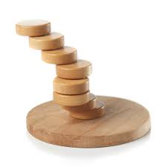
Balance Recommendations
  Persons with stroke should be evaluated for balance, balance confidence, and fall risk. (Class I, LOE C)
  Persons with stroke who have poor balance, low balance confidence, fear of falls, and/or are at risk for falls should be provided with a balance training program. (Class I, LOE A)
  Persons with stroke should be prescribed and fit with an assistive device and/or orthosis if appropriate to improve balance. (Class I, LOE A)
science is why

Slide 21
Recommendations for Motor Impairment and Recovery: Deconditioning and Fitness
  Following successful screening, an individually-tailored exercise program is indicated to enhance cardiorespiratory fitness and reduce the risk of stroke recurrence. (Class I, LOE A, for improved fitness; LOE B, for reduction of stroke risk)
  After completion of formal stroke rehabilitation participation in a program of exercise or physical activity at home and/or in the community is recommended. (Class I, LOE A)
science is why

Slide 22
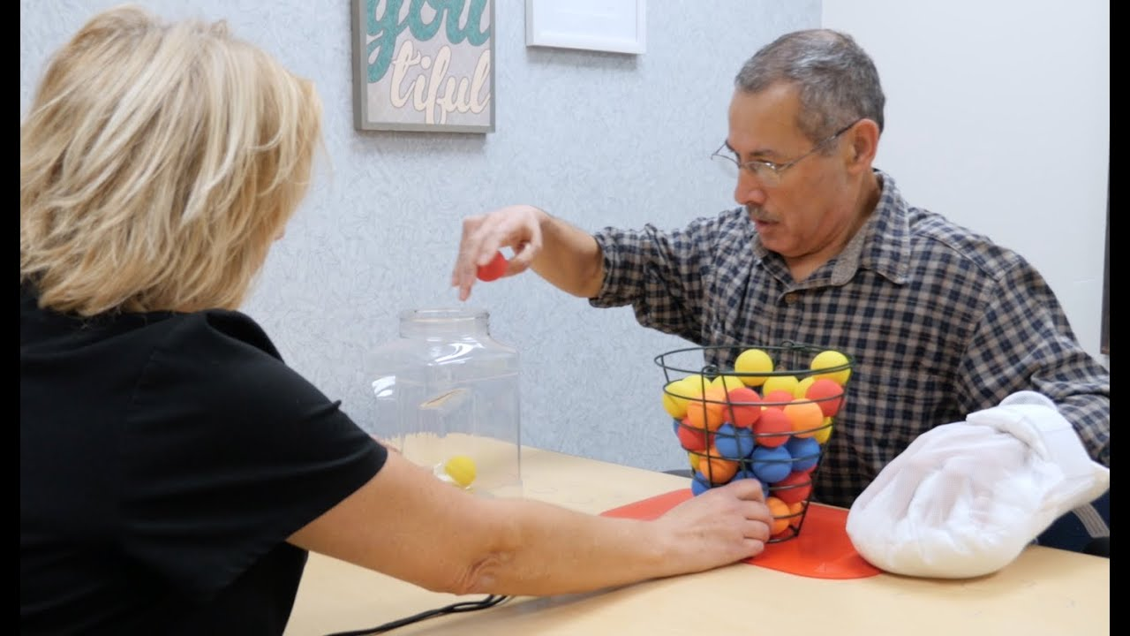
Upper Extremity Activity Recommendations
  Functional tasks should be practiced, i.e. task-specific training, where the tasks are graded to challenge individual capabilities, practiced repeatedly, and are progressed in difficulty on a frequent basis. (Class I, LOE A)
  All persons with stroke should receive ADL training, tailored to individual needs and eventual discharge setting. (Class I, LOE A)
  All persons with stroke should receive IADL training, tailored to individual needs and eventual discharge setting. (Class I, LOE B)
  Constraint-induced movement therapy (CIMT) or its modified version (mCIMT) is reasonable to consider for eligible stroke survivors. (Class IIa, LOE A)
  Robotic therapy is reasonable to consider to deliver more intensive practice for persons with moderate to severe upper limb paresis. (Class IIa, LOE A)
science is why

Slide 23
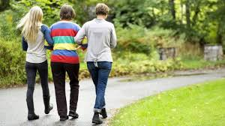
Social and Family Caregiver Support
  It may be useful for the family/caregiver to be an integral component of stroke rehabilitation. (Class IIb, LOE A)
  It may be reasonable that family/caregiver support provide some or all of the following on a regular basis: (Class IIb, LOE A)
    Education
    Training
    Counseling
    Development of a support structure
    Financial assistance
  It may be useful to have the family/caregiver involved in decision making and treatment planning as early as possible, and throughout the duration of the rehabilitation process. (Class IIb, LOE B)

Slide 24
Transition in care
  It is reasonable to consider individualized discharge planning in the transition from hospital to home. (Class IIa, LOE B)
  Patients with stroke receiving comprehensive ADL, IADL, and mobility assessments, including evaluation of the discharge living setting, should be considered candidates for community or home-based rehabilitation when feasible. Exclusions include persons with stroke who require daily nursing services, regular medical interventions, or specialized equipment or inter-professional expertise. (Class I, LOE A)
  It is reasonable that care-givers, including family members, be involved in training and education directly related to home-based rehabilitation programs and be included as active partners in the planning and implementation or treatment activities under the supervision of professionals. (Class IIa, LOE B)
science is why

Slide 25
Recommendations for Recreational and Leisure Activity
  It is reasonable to promote engagement in leisure and recreational pursuits, particularly through the provision of information on the importance of maintaining an active and healthy lifestyle. (Class IIa, LOE B)
  It is reasonable to foster the development of self-management skills for problem solving regarding overcoming barriers to engagement in active activities. (Class IIa, LOE B)
  It is reasonable to start education and self-management skill development about leisure/recreation activities during and in conjunction with in-patient rehabilitation. (Class IIa, LOE B)
science is why

Slide 26
Recommendations: Return to Driving
  Individuals who appear to be ready to return to driving, as demonstrated by successful performance on fitness-to-drive tests, should have an on-the-road test administered by an authorized person. (Class I, LOE C)
  It is reasonable that individuals be assessed for cognitive, perception, physical, and motor abilities to ascertain readiness to return to driving, according to state and local laws. (Class IIa, LOE B)
  A driving simulation assessment may be considered for predicting fitness-to- drive. (Class IIb, LOE C)
science is why

Slide 27
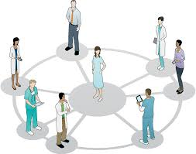
Stroke rehabilitation requires a sustained and coordinated effort from a large team, including the patient and his or her goals, family, and friends, other caregivers (e.g., personal care attendants), physicians, nurses, physical and occupational therapists, speech/language pathologists, recreation therapists, psychologists, nutritionists, social workers, and others.

